Slide 1
Hnefatafl
CS414 Object-Oriented Design
--Party A

Slide 2
CONTENTS
The perfection of documents
User Stories
CRC Card & Diagram
Development Manual
Sprint Review and Retrospective

Slide 3
The perfection of documents
1. User stories
2.CRC card & class diagram
3.Acceptance Criteria
4. Task for User stories
5. Development Manual
Picture Source: the picture from the network. https://zhuanlan.zhihu.com/p/33300643

Slide 4
Task for User Stories
·As a user, I want to be able to play Hnefatafl.
Priority:1
Task:
1.Write code about basic game screen
2.Write code to achieve chess movement
3.Write code to achieve the chessmen eat the opponent's chessmen
4.Write code to achieve update game screen
5.Write code to achieve the logout button

Slide 5
Task for User Stories
• As a user, I want to know when it is my turn.
Priority:2
Task:
1.Write code to implement the round prompt interface
2.Write code to click on the screen space, the prompt screen automatically disappear

Slide 6
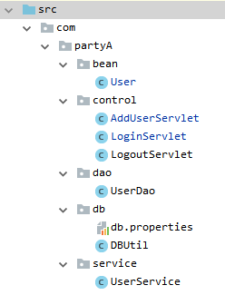
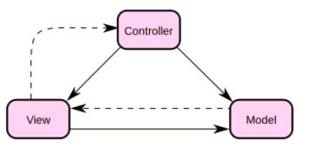
Login & Register
MVC model

Slide 7
User Stories

Slide 8

User Stories
1. As a user, I want to register to this platform by using an email, nickname and a password.
2. As a user, I want to login to this platform using the account I registered.
3. As a user, I want to be able to play Hnefatafl.
4. As a user, I want to know when it is my turn.
5. As a user, I want to be able to logout from my account when I do not want to play, and receive a prompt before it exits.

Slide 9
Move methods
Gameboard
int getCount()
boolean validPosition()
boolean validMove()
void move()
Match
String prompt()
Piece
String getColor()
String getPosition()
void setPosition()
ArrayList<String> legalMoves()

Slide 10
CRC Cards &
Class Diagram

Slide 11
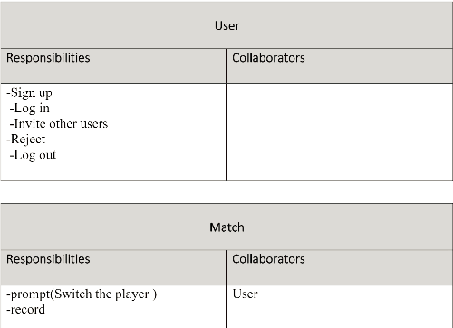
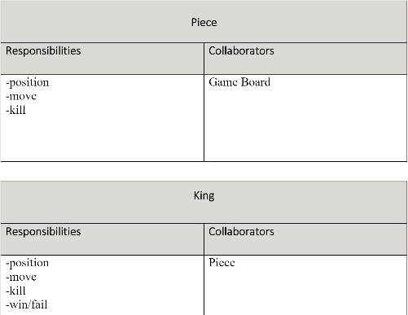
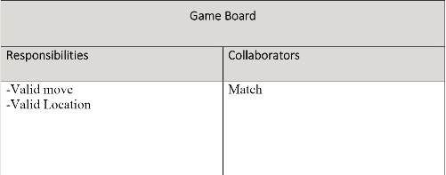
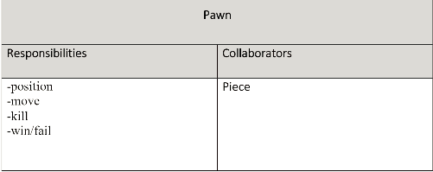
CRC Cards &Class Diagram

Slide 12
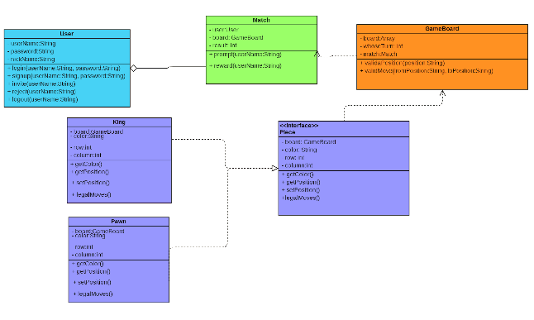
CRC Cards &Class Diagram

Slide 13
Development
Manual

Slide 14
Development Manual
The Development Manual is a comprehensive, composite artifact that gathers all information required to manage the project.
It is like a user guide, which is a short reference to some particular
aspects of a software project.
The Development Manual contains all essential information for the
user to make full use of the information system.
This manual includes a description of the system functions and
capabilities, contingencies and alternate modes of operation,
and step-by-step procedures for system access and use.

Slide 15
Development Manual
Hnefatafl is a family of 2-player Viking board games. Right now, we're implementing the
popular 11x11 variant. To develop this game, we need to follow the following steps:
STEP 1: Download the JDK
STEP 2: Set Up a Development Environment
STEP 3: Application
Testing Phase: 3 A's
1. Arrange: consists of a few lines of code that are used to declare and initialize the objects
2. Act: is usually a few lines of code where we perform the actions,
whether it is some calculation or modify the state of our objects.
3. Assert: usually consists of a single line of code where we verify that the outcome of
the Act part was made successfully. Testing improves the quality of the code and it makes
the development process more Agile.

Slide 16
Development Manual
To run the tests:
Eclipse provides a couple of ways to run individual test methods,
one from within the editor itself and another from the JUnit view.

Slide 17
Sprint Review
and Retrospective

Slide 18
Sprint Review and Retrospective
Daily scrums:
Disscussed progress
Review:
Went over results of sprint
Made changes as needed accotding to product owner
Retrospective:
Identified what could improve
Identified what went well

Slide 19
Reference
1.Sten Helmfrid(2005),Hnefatafl - the Strategic Board Game of the Vikings. http://hem.bredband.net/b512479/#Chap9
2.Dragonheel’s Lair ,Rules of the game Hnefatafl. http://www.dragonheelslair.com/en/ruleshnef.php

Slide 20
THANK YOU FOR WATCHING

